Slide 1

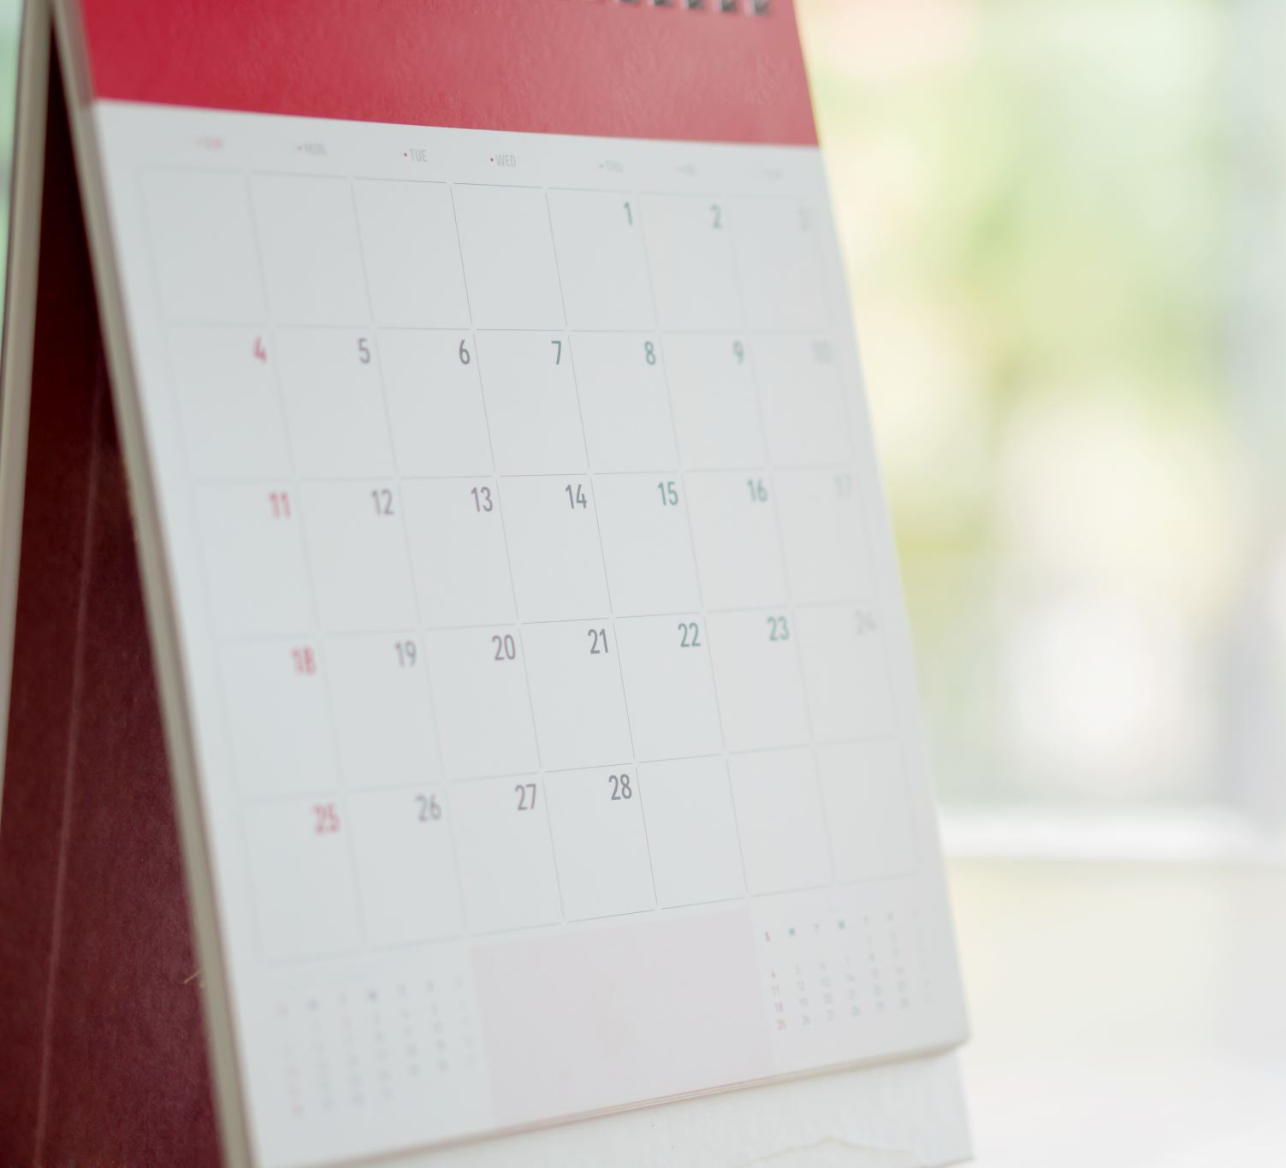
Week 2
Heston Moyers
Self Reflective Journal Report

Slide 2
Questions I want answered
How does this class work.
What are the requirements of this class?
Who is in my group?

Slide 3
Group Meeting
This week we met with our group and created an outline for the remainder of the semester.
We decided what topics we were each going to teach and the weeks we are going to teach them.
We all signed up for slack which is where we will stay in communication between group meetings.
To implement the Agile methodology we used Standup Alice as part of slack and would record What we did yesterday, what we plan to do tomorrow and if there are any things in our way that could cause us not to achieve that goal.

Slide 4
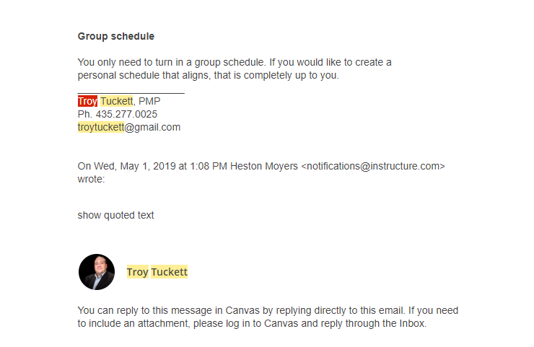
Were my questions answered?
As we met as a group we went over the syllabus and that answered all my questions. I also emailed the teacher to ask if we must create a personal schedule as well.

